Slide 1

Global mHealth Report
mHealth Interest Group Webex
24 November 2015

Slide 2
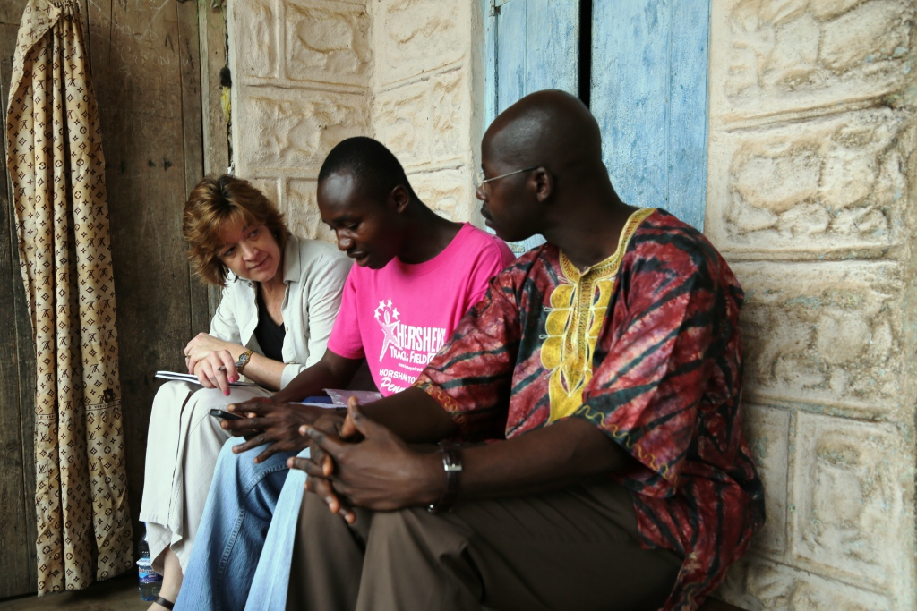

Slide 3
World Vision is a proven partner with Ministries of Health and others who share a vision to end preventable deaths and malnutrition of vulnerable women and children by leveraging digital health, or mHealth.
We believe that mobile technology in the hands of frontline and community health workers is a game changer for global health: a critical tool to realise the new Sustainable Development Goals for health and nutrition. I’m particularly proud of this summary of World Vision’s mHealth projects in 16 countries.
I want to thank our donors, partners and supporters for working with us to ensure that children survive, thrive and become the leaders of tomorrow.
Martha Newsome,
Partnership Leader – Sustainable Health,
World Vision International

Slide 4

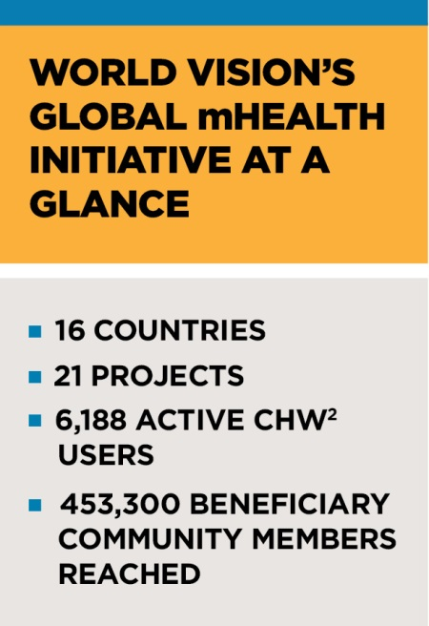
Global mHealth Report – methods
Background and context: literature review focusing on mHealth standards of practice for development industry
Data collected from 19 Countries
  Current reach: number of CHWs & beneficiaries, trainings held
  Scale up plans
  IT resources; M&E data availability
Data from 3 countries excluded because not in implementation phase: Ghana, Mauritania, Philippines
Data verification: individual meetings with country teams; desk review of project documentation and M&E reports
Notes:
Data was collected from 19 countries but only 16 countries were utilized in external report.
Extensive follow-up was required for countries featured in external report.
Literature review conducted to provide broad scope and introduction in internal report.

Slide 5
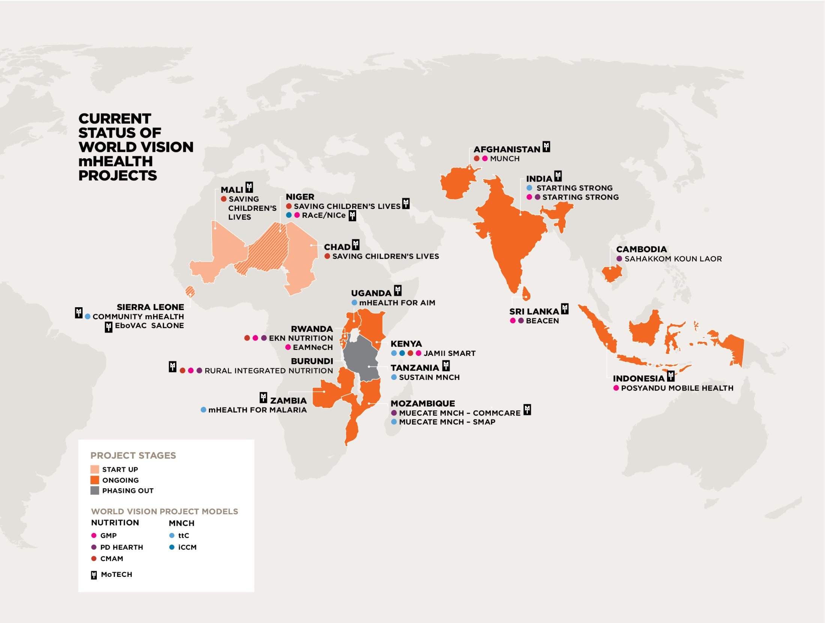
Notes:
Map graphic included in external report.

Slide 6
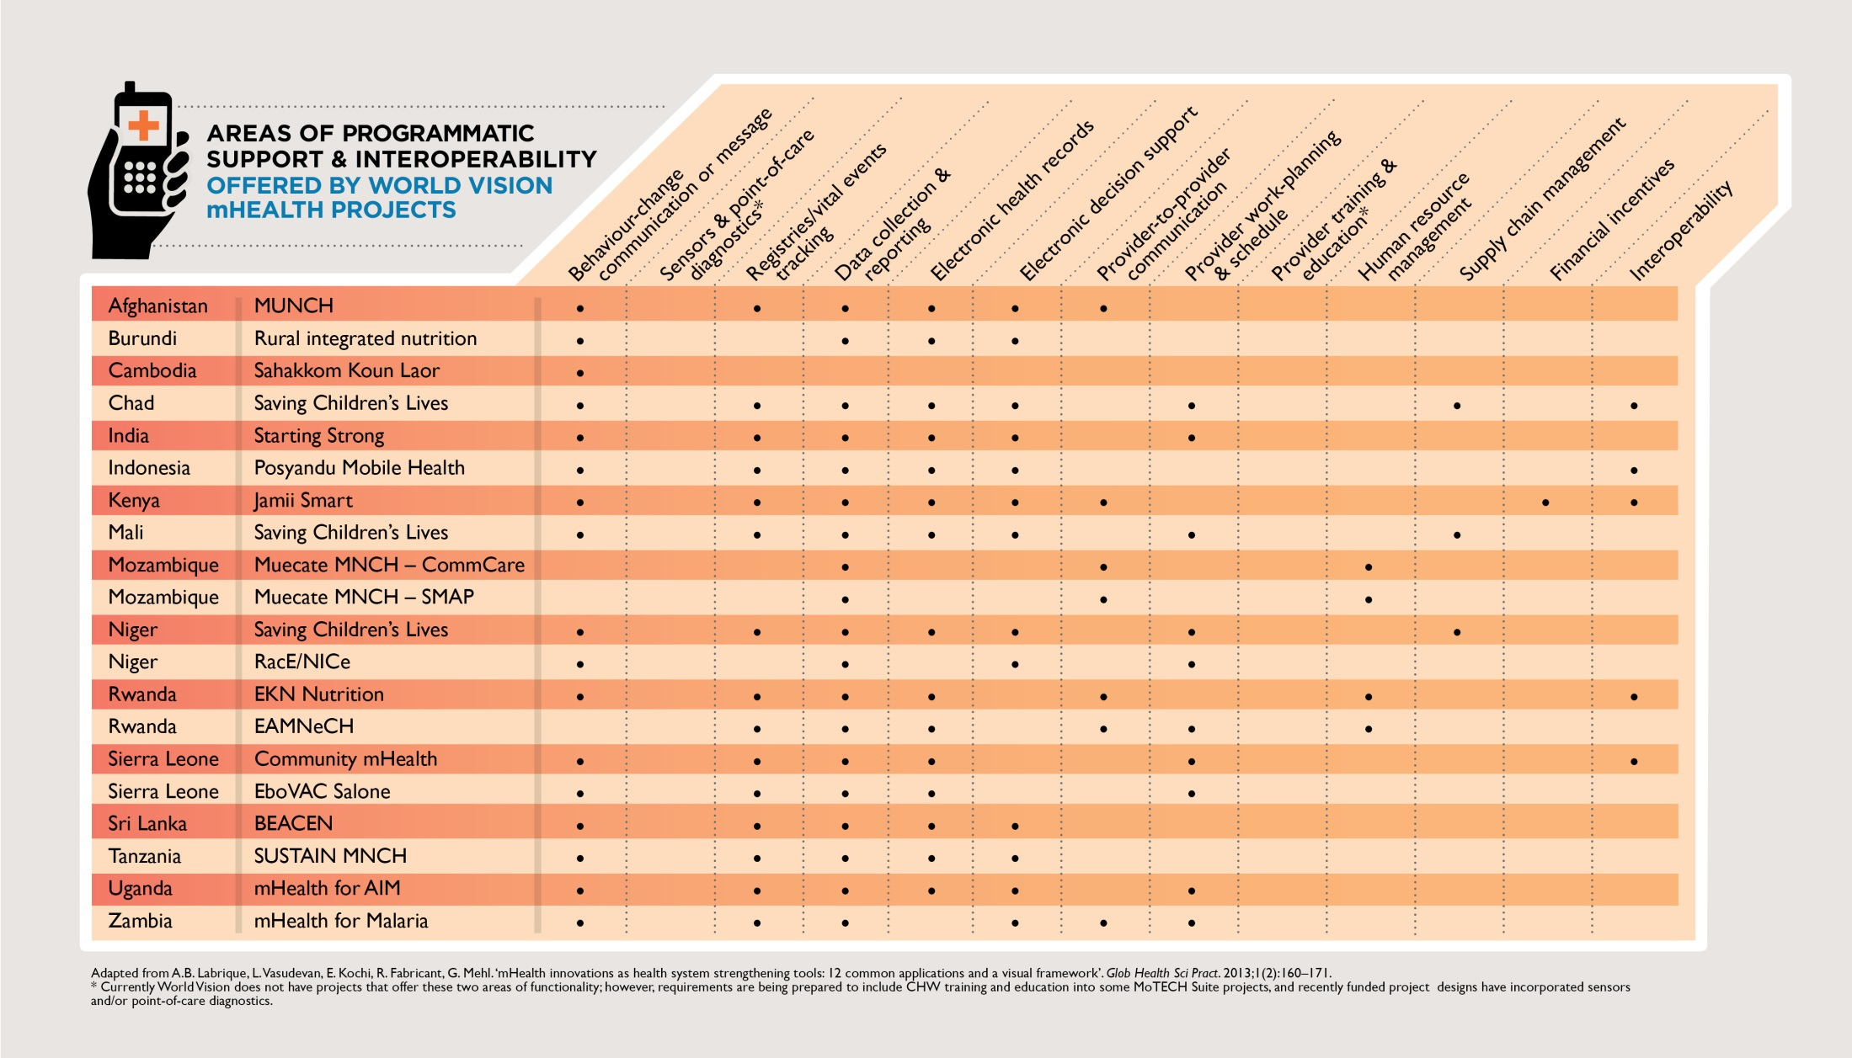

Slide 7
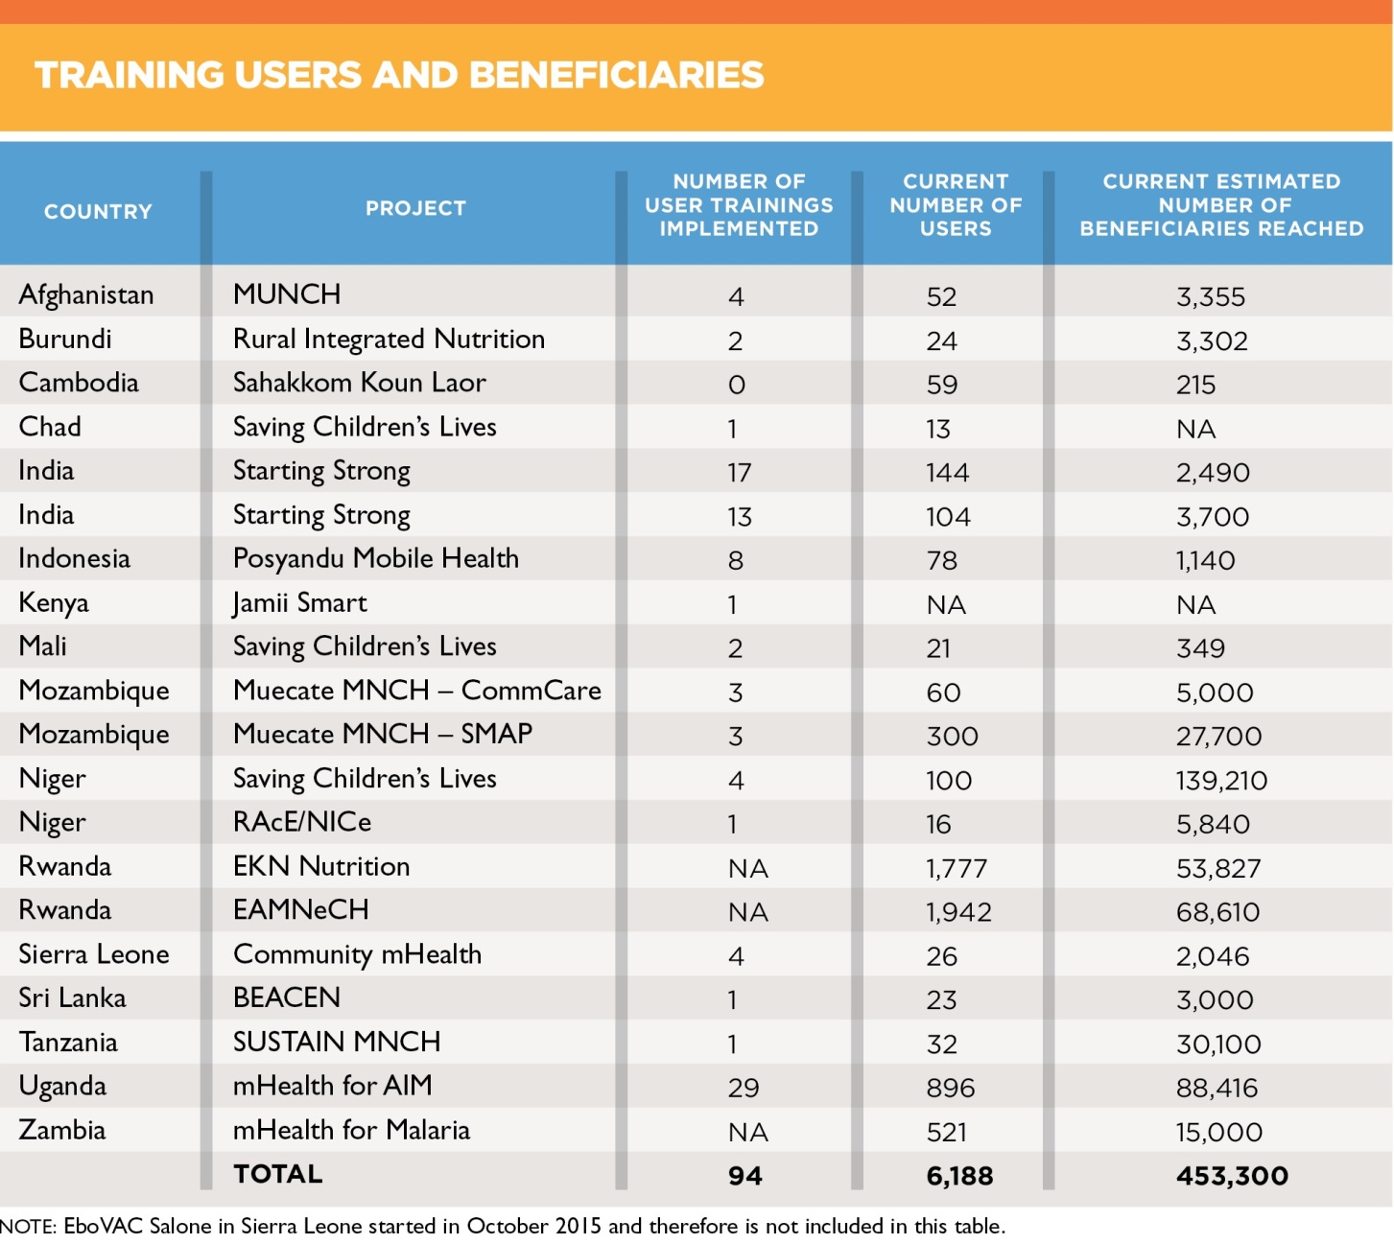

Slide 8
India – Early Results
Methods:
  Comparison between baseline and mid-term in programme areas only
  Population-based probabalistic cluster sampling of >1000 households per round
Interpretation
Good progress against key maternal health and nutrition indicators
Limitation
Comparision group measured at baseline is available for endline in 2017
mHealth related monitoring data to show causal chain unavailable
* Differences between prevalences at baseline and mid-term for the IFA and postnatal care indicators are statistically significant at least at the p<.05 level.

Slide 9
Indonesia – Early Results
External research/evaluation partner: Institute of Development Studies UK.
Selected results:
  mPosyandu improves data accuracy
    11% of paper-based calculations were inaccurate
    34% of paper records showed incorrect values for child age
  CHWs and caregivers perceived mPosyandu as improving service quality
    CHWs who used mHealth more often gave immediate growth monitoring feedback to beneficiaries (57%) than those who didn’t use mHealth (7%)
    mPosyandu provides CHWs with more options (tools) to improve nutrition counseling
  There is a wide acceptance of the mPosyandu tool (91%)
Interpretation
Excellent example of how to build an evidence base for mHealth

Slide 10
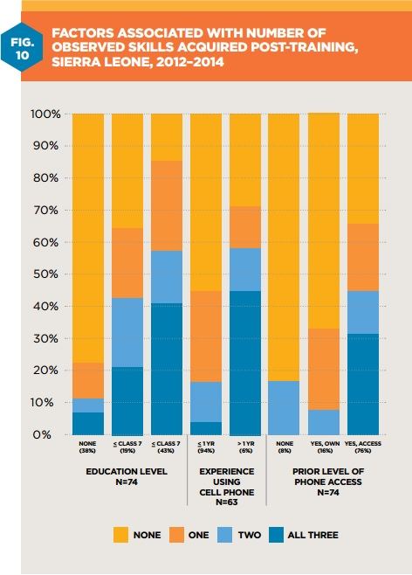
Sierra Leone
Methods
Observation of trainee skill attainment (n=75) immediately post-training
Interpretation
Trainees with less education and less prior experience with or access to a cell phone need additional support to master the mHealth application
Limitation
Small sample size.
Uncertainty around prior phone access as a factor

Slide 11
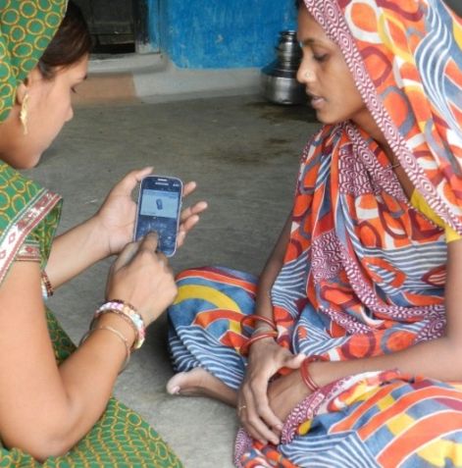
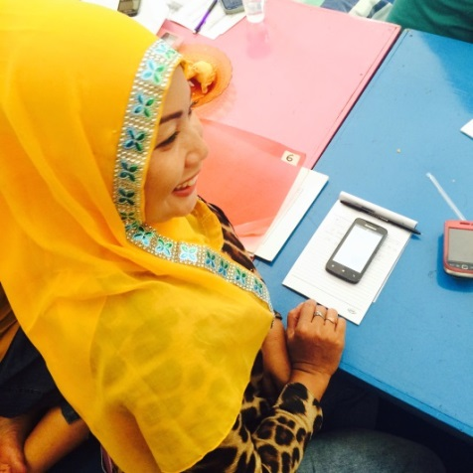
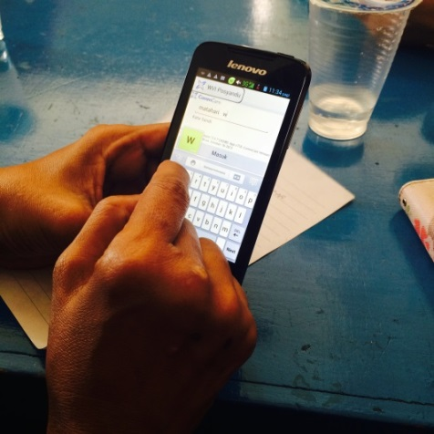
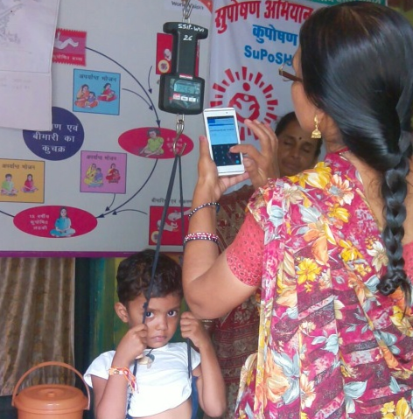
Elements of Scale
Partnering as Fundamental Sustainability
Interoperability is linked to long term viability
IT Minimum Standards
Contribute to evidence base

Slide 12
Phase 1 – Proposal/design/pilot
Recommendations
Projects must, from inception, envision & build a roadmap to achieve interoperability
Community-systems strengthening must be a priority
Projects must, from inception, consider how to achieve a sustainable cost model
mHealth and ICT4D ecosystems must be studied prior to project launch
Increase Government (MoH and other agency) involvement in initial pilot design & deployment
Notes:
Developers hypothesize that increasing information sharing and access along the healthcare continuum will improve health outcomes.
mHealth programs should be planned according to the local community context for they are targeted.
Ensuring projects have a long-term funding source, garnered with in-country support, will increase chances of scalability and sustainability.
Recommendation 4 will allow WV to understand the potential entry points for World Vision and whether offering a new tech solution or to support an existing solution will be most beneficial to promote scale-up.
Field teams must initiate substantive discussions with governments to permit a project design that aligns their future digital health goals, offers functionalities that strengthen community health systems and will be interoperable with a maturing HMIS.

Slide 13
Phase II – Preparation for scale up
Recommendations
Projects must begin with and maintain minimum IT standards*
Increase partnerships with likeminded NGOs
Bolster evidence base by refining M&E framework and offering generic M&E tools
*See more detail in report
Notes:
Recommendation 6 will allow WV to understand the potential entry points for World Vision and whether offering a new tech solution or to support an existing solution will be most beneficial to promote scale-up.
The need for recommendation 7 was made clear during follow-up with feature countries. Level 2 and 3 technical IT skills must be focused upon to create sustainable IT capacity building. IT issues must be resolved on a daily basis to help train CHWs and decrease the need for additional support.
8. Today, mHealth pilots are scattered and fragmented leading to a heavy duplication of efforts. By collaborating with other relevant organizations and beginning the global effort to consolidate efforts, World Vision could emerge as a leader in mHealth scalability.

Slide 14
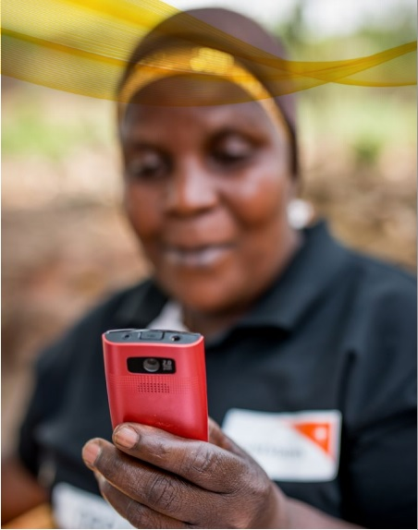
Limitations
Report does not represent full pipeline of projects (those in proposal/design phase excluded)
Unable to get clear picture of funding allocated to mHealth

Slide 15
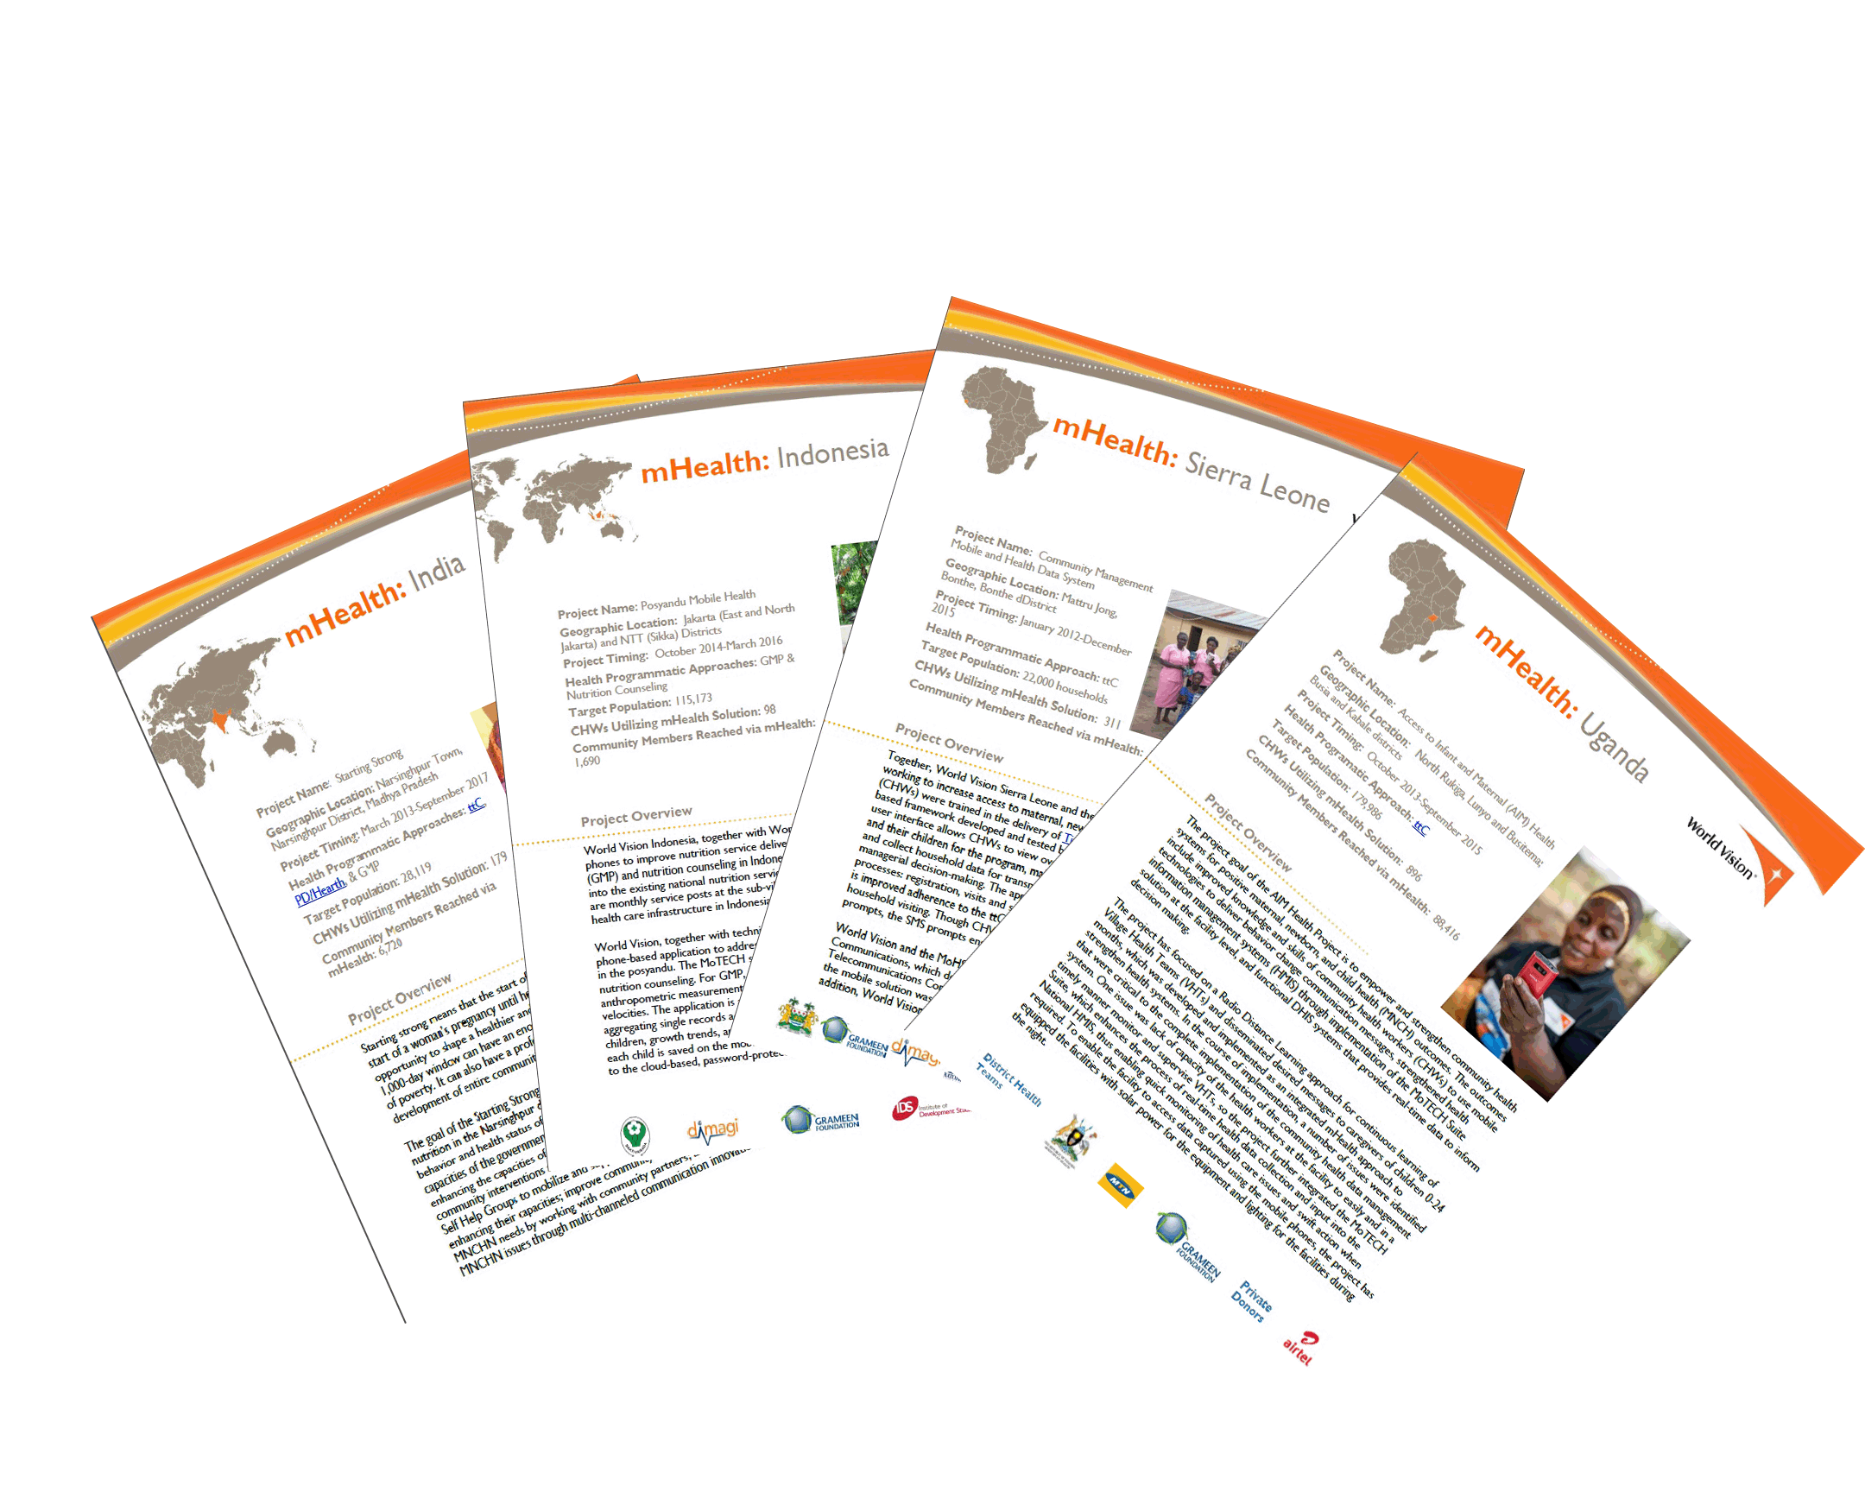
Country Project Factsheets
Location
Project duration
Health programmatic approach
Target population
Reach: CHWs and beneficiaries
Project overview
Donors, stakeholders and other partners
In-country point-of-contact

